Slide 1
Discrete Mathematics and Its Application 7th edition, 2001
Kenneth H. Rosen

Slide 2
Welcome to Discrete Mathematics Spring 2018
Instructor: Niu Shao Zhang

Slide 3
Chapter 2
Basic Structures:
Sets
Functions
Sequences
Sums
Matrices

Slide 4
Chapter Summary
Sets
The Language of Sets
Set Operations
Set Identities
Functions
Types of Functions
Operations on Functions
Computability
Sequences and Summations
Types of Sequences
Summation Formulae
Set Cardinality
Countable Sets
Matrices
Matrix Arithmetic

Slide 5
§2.1 Sets （集合）
Introduction to Set Theory
A set is a new type of structure, representing an unordered collection (group, plurality) of zero or more distinct (different) objects.
Set theory deals with operations between, relations among, and statements about sets.
Sets are ubiquitous in computer software systems.
All of mathematics can be defined in terms of some form of set theory (using predicate logic).

Slide 6
§2.1 Sets （集合）
A set is a collection or group of objects（对象） or elements（元素） or members（成员）. (Cantor 1895)
A set is said to contain（包含） its elements.
There must be an underlying universal set（全集） U, either specifically stated or understood.

Slide 7
Notation
Specification by predicates（谓词）:
S= {x| P(x)},
P(x) denote a sentence or statement P concerning the variable object x.
S contains all the elements from U which make the predicate P true.

Slide 8
Notation
list the elements between braces:
S = {a, b, c, d}={b, c, a, d, d}
(Note: listing an object more than once does not change the set. Ordering means nothing.)

Slide 9
Notation
Brace(大括号) notation with ellipses(省略号):
S = { . . . , -3, -2, -1},
the negative integers.

Slide 10
Notation
x is a member of S or x is an element of S:
x ∈ S.
x is not an element of S:
x ∉ S.

Slide 11
Examples
{x |x is a positive integer less than 4} ={1,2,3}
{x |x is a letter in the word “byte”} ={b, y, t, e}
If A={BASIC,PASCAL,ADA} and B={ADA,PASCAL,BASIC}, then A=B.

Slide 12
Some Important Sets
N = natural numbers = {0,1,2,3….}
Z = integers = {…,-3,-2,-1,0,1,2,3,…}
Z⁺ = positive integers = {1,2,3,…..}
R = set of real numbers
R⁺ = set of positive real numbers
C = set of complex numbers.
Q = set of rational numbers

Slide 13
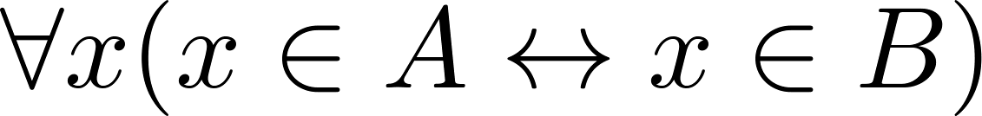
Set Equality
Definition: Two sets A and B are equal （相等） if and only if they have the same elements.
Therefore if A and B are sets, then A and B are equal if and only if .
We write A = B if A and B are equal sets.
{1,3,5} = {3, 5, 1}
{1,5,5,5,3,3,1} = {1,3,5}

Slide 14
Empty set（空集）
Definition: The void set, the null set, the empty set, denoted {} or ∅, is the set with no members.
Example:
{x |x is a real number and x²=-1}= ∅.

Slide 15
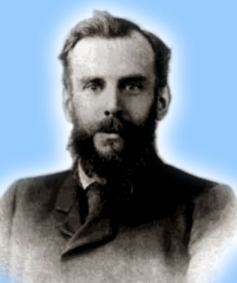
Venn Diagrams
John Venn 1834-1923
0
2
4
6
1
8
Even integers from 2 to 9
-1
3
5
7
9
Odd integers from 1 to 9
Positive integers less than 10
Primes <10
Integers from -1 to 9
Notes:
With Venn diagrams, you can see that one set is a subset of another just by seeing that you can draw an enclosure around its members that fits completely inside an enclosure drawn around the larger set’s members.

Slide 16
Subsets（子集）
Definition: The set A is a subset of the set B, or A contained in（包含于） B ,denoted A⊆ B, iff（当且仅当）
∀x ( x ∈A → x ∈B )
If A is not a subset of B ,denote A ⊈ B.
Because a ∈ ∅ is always false, ∅ ⊆ S ,for every set S.
Because a ∈ S → a ∈ S, S ⊆ S, for every set S.

Slide 17
Another look at Equality of Sets
Recall that two sets A and B are equal, denoted by A = B, iff
Using logical equivalences we have that A = B iff
This is equivalent to
A ⊆ B and B ⊆ A

Slide 18
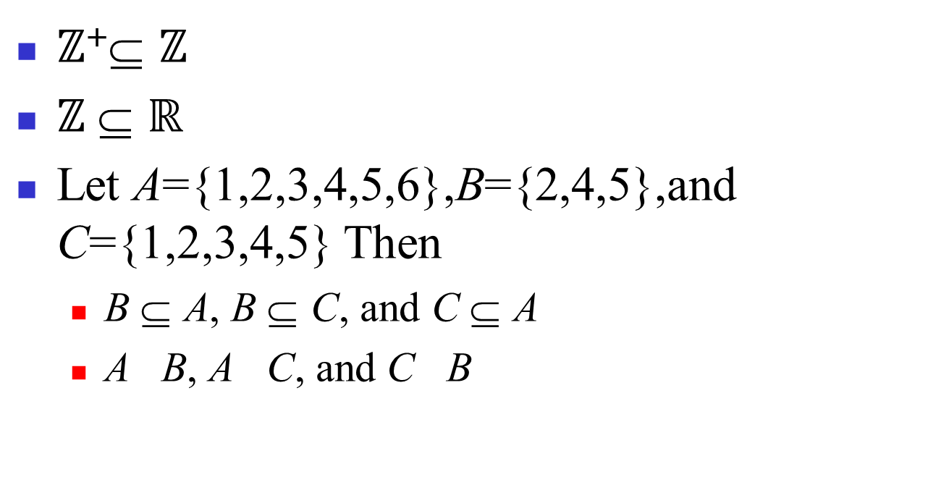
Examples

Slide 19
Definition
Definition: If A ⊆ B but A ≠ B the we say A is a proper subset（真子集） of B, denoted
A ⊂ B (in some texts).
If A ⊂ B, then
is true.
Venn Diagram
U
B
A

Slide 20
Venn diagrams（文氏图）
Diagrams used to show relationships between sets after the British logician John Venn
Example:
B
B
A
A
A ⊆B
A B

Slide 21
Set Cardinality（基数）
Definition: If there are exactly n distinct(不同的) elements in S where n is a nonnegative integer, we say that S is finite. Otherwise it is infinite.
Definition: The cardinality of a finite set A, denoted by |A|, is the number of (distinct) elements of A.
If the cardinality is a natural number (in N), then the set is called finite, else infinite.

Slide 22
Set Cardinality
Examples:
|ø| = 0
Let S be the letters of the English alphabet. Then |S| = 26
|{1,2,3}| = 3
|{ø}| = 1
The set of integers is infinite.

Slide 23
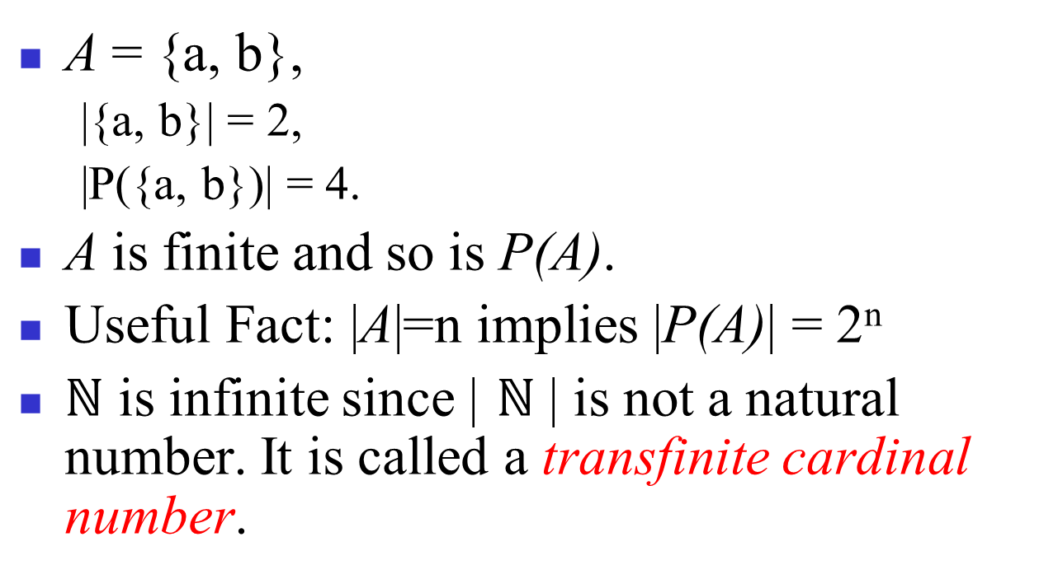
Cardinality - Example

Slide 24
The power set
Definition: The set of all subset of a set A, denoted P(A), is called the power set（幂集） of A.
If A = {a, b} then
P(A) = {∅, {a}, {b}, {a,b}}

Slide 25
Note
Sets can be both members and subsets of other sets.
Example:
A = {∅,{∅}}.
A has two elements and hence four subsets:
∅, {∅}, {{∅}}. {∅,{∅}}
Note that ∅ is both a member of A and a subset of A!

Slide 26
Example
Let A be a set and let B={A,{A}},Then
A∈B and {A} ∈B
{A}⊆B and {{A}} ⊆B.
A B

Slide 27
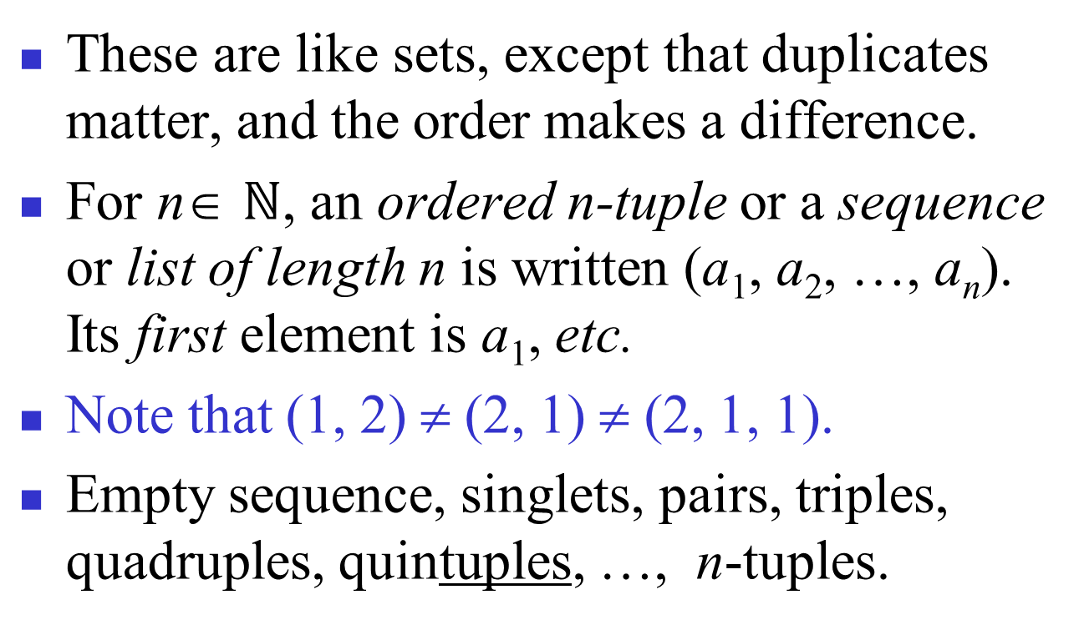
Ordered n-tuples
Contrast with sets’ {}
Notes:
Sometimes people also define “bags”, which are unordered collections in which duplicates matter. If you have a bag of coins, they are in no particular order, but it matters how many coins of each type you have.

Slide 28
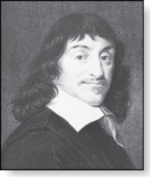
Cartesian Product （笛卡尔积）
Definition: The Cartesian Product of two sets A and B, denoted by A × B is the set of ordered pairs (a,b) where a ∈ A and b ∈ B .
Example:
A = {a,b} B = {1,2,3}
A × B = {(a,1),(a,2),(a,3),
(b,1),(b,2),(b,3)}
René Descartes (1596-1650)

Slide 29
Example
A = {a,b}, B = {1, 2, 3}
A × B = {<a, 1>, <a, 2>, <a, 3>, <b, 1>, <b, 2>, <b, 3>}
What is B × A? A × B × A?
If |A| = m and |B| = n, what is |A × B|?

Slide 30
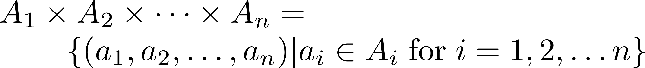
Cartesian Product （笛卡尔积）
Definition: The cartesian products of the sets A₁,A₂,……,A_{n}, denoted by A₁ × A₂ × …… × A_{n} , is the set of ordered n-tuples (a₁,a₂,……,a_{n}) where a_{i} belongs to A_{i} for i = 1, … n.

Slide 31
Cartesian Product （笛卡尔积）
Example: What is A × B × C where A = {0,1}, B = {1,2} and C = {0,1,2}
Solution: A × B × C = {(0,1,0), (0,1,1), (0,1,2),(0,2,0), (0,2,1), (0,2,2),(1,1,0), (1,1,1), (1,1,2), (1,2,0), (1,2,1), (1,1,2)}

Slide 32
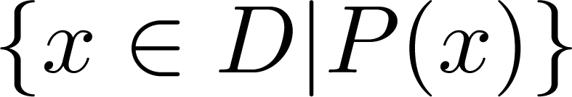
Truth Sets of Quantifiers
Given a predicate P and a domain D, we define the truth set of P to be the set of elements in D for which P(x) is true. The truth set of P(x) is denoted by
Example: The truth set of P(x) where the domain is the integers and P(x) is “|x| = 1” is the set {-1,1}

Slide 33
homework
6,10,16,22,32,44

